Slide 1
Welcome to Shrewsbury High School
8th Grade Curriculum Night
Incoming Class of 2028
February 15, 2024

Slide 2
Agenda
Welcome
Introductions of Leadership Team
Purpose of the Event

Slide 3
Small Group Presentations
Rotate to visits with directors in four 12-15 minute sessions to hear about programming by department. Format allows you to ask questions and learn more, not be sitting in one spot for an hour, and have a movement break.

Slide 4
Not attending Oak MS?
Students from other schools than Oak Middle-leave info in the main office with Director of School Counseling, Angie Flynn or aflynn@shrewsbury.k12.ma.us

Slide 5
Students on IEPs
Check in with Director of Special Education, Meghan de Leon, in the main office, or mdeleon@shrewsbury.k12.ma.us

Slide 6
Graduation Requirements
MCAS: English, Math & Science
105 credits
Attendance

Slide 7
Typical Freshman Schedule:
English 9 (Honors, A-Level)
Mathematics
Algebra & Geometry I (A-Level)
Algebra & Geometry II (Honors, Research Methods or A-Level)
Science
Introductory Physics (Honors, A-Level)
Biology (Honors, Research Methods)
World Civilizations (A-Level)
World Language
French, Mandarin, Spanish, Latin, Heritage Portuguese, Heritage
Spanish, or Linguistics
Physical Education
Health
• Elective (Visual or Performing Arts or Pathway)

Slide 8
Innovation Career Pathways
Business
Childcare & Child Development
Computer Science
TV Production & Film
Engineering: Manufacturing
Life Sciences: Biomedical
Industry Internship

Slide 9
Designing an appropriate program:
• Review the 2024-25 Program of Studies
• Discuss course offerings/opportunities
and ask questions
• Plan for next year and beyond

Slide 10
Specific Department and Course Information QR Codes

Slide 11
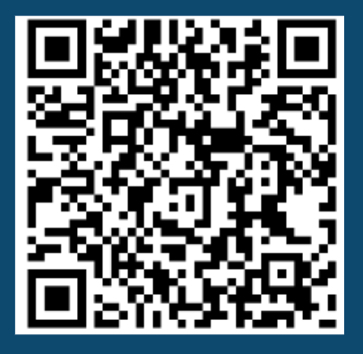
Visual Art, Performing Arts, & Technology, Media and Business

Slide 12
World Language, Physical Education, Health, and Family Consumer Science

Slide 13
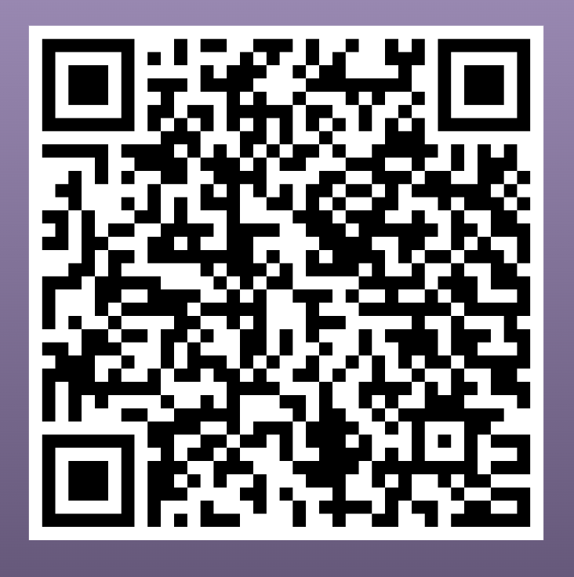
English and Mathematics

Slide 14
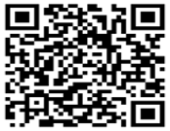
Social Sciences and
Science & Engineering

